Slide 1

Impact of Clean Air Policy on PM2.5 (2018–2022)
Data Analytics Project
Pooja Patel

Slide 2

Introduction: Addressing PM2.5
PM2.5, or fine particulate matter, is a significant public health concern globally, linked to respiratory and cardiovascular diseases.
This project aims to evaluate the effectiveness of the Clean Air Policy in reducing PM2.5 levels across various regions in the United States.

Slide 3

Data Overview
Dataset comprises 54,900 region–day observations spanning 2018–2022.
Key variables include PM2.5 levels, temperature, rainfall, mobility index, unemployment rate, policy activation status, and region type (Urban, Rural, Suburban).
Data cleaning involved removing 100 duplicate entries, imputing approximately 200 missing values, and clipping unrealistic values to ensure data quality.

Slide 4
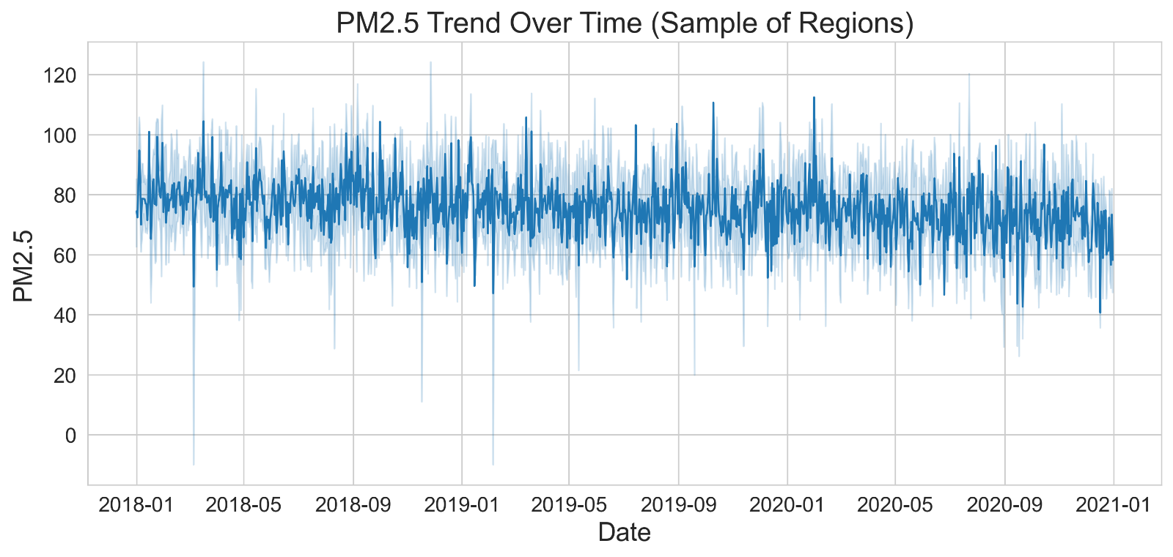
Exploratory Analysis
Visual 1 – PM2.5 Trend Over Time

Slide 5
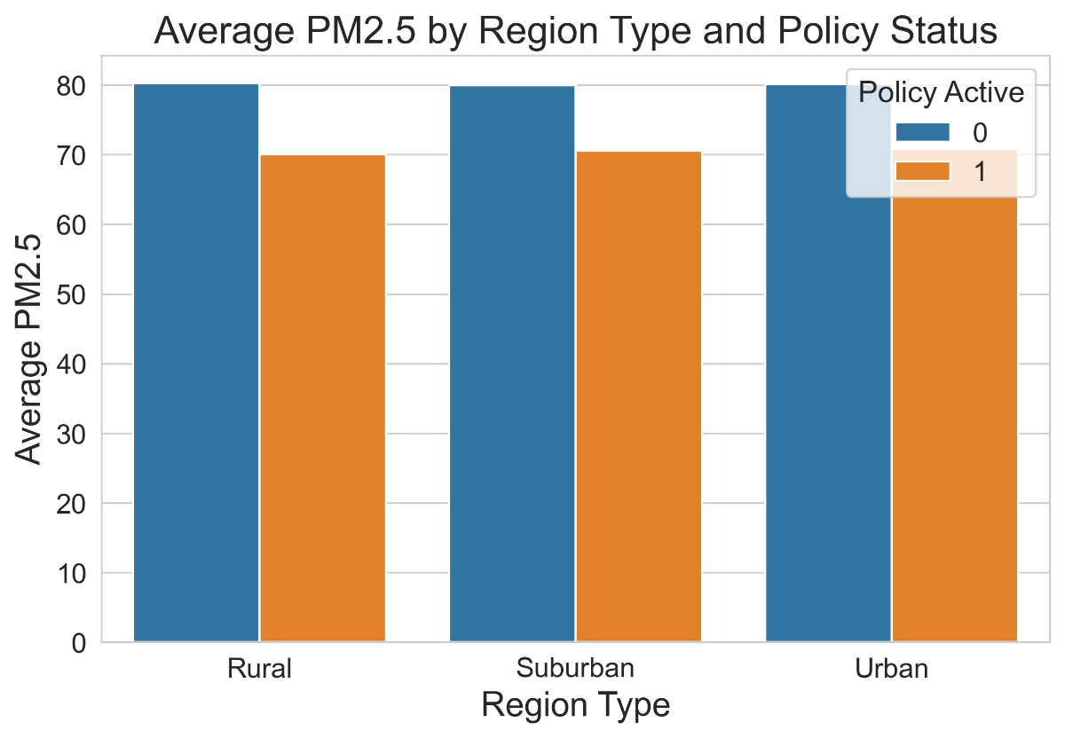
Visual 2 – Treated vs Control Comparison

Slide 6
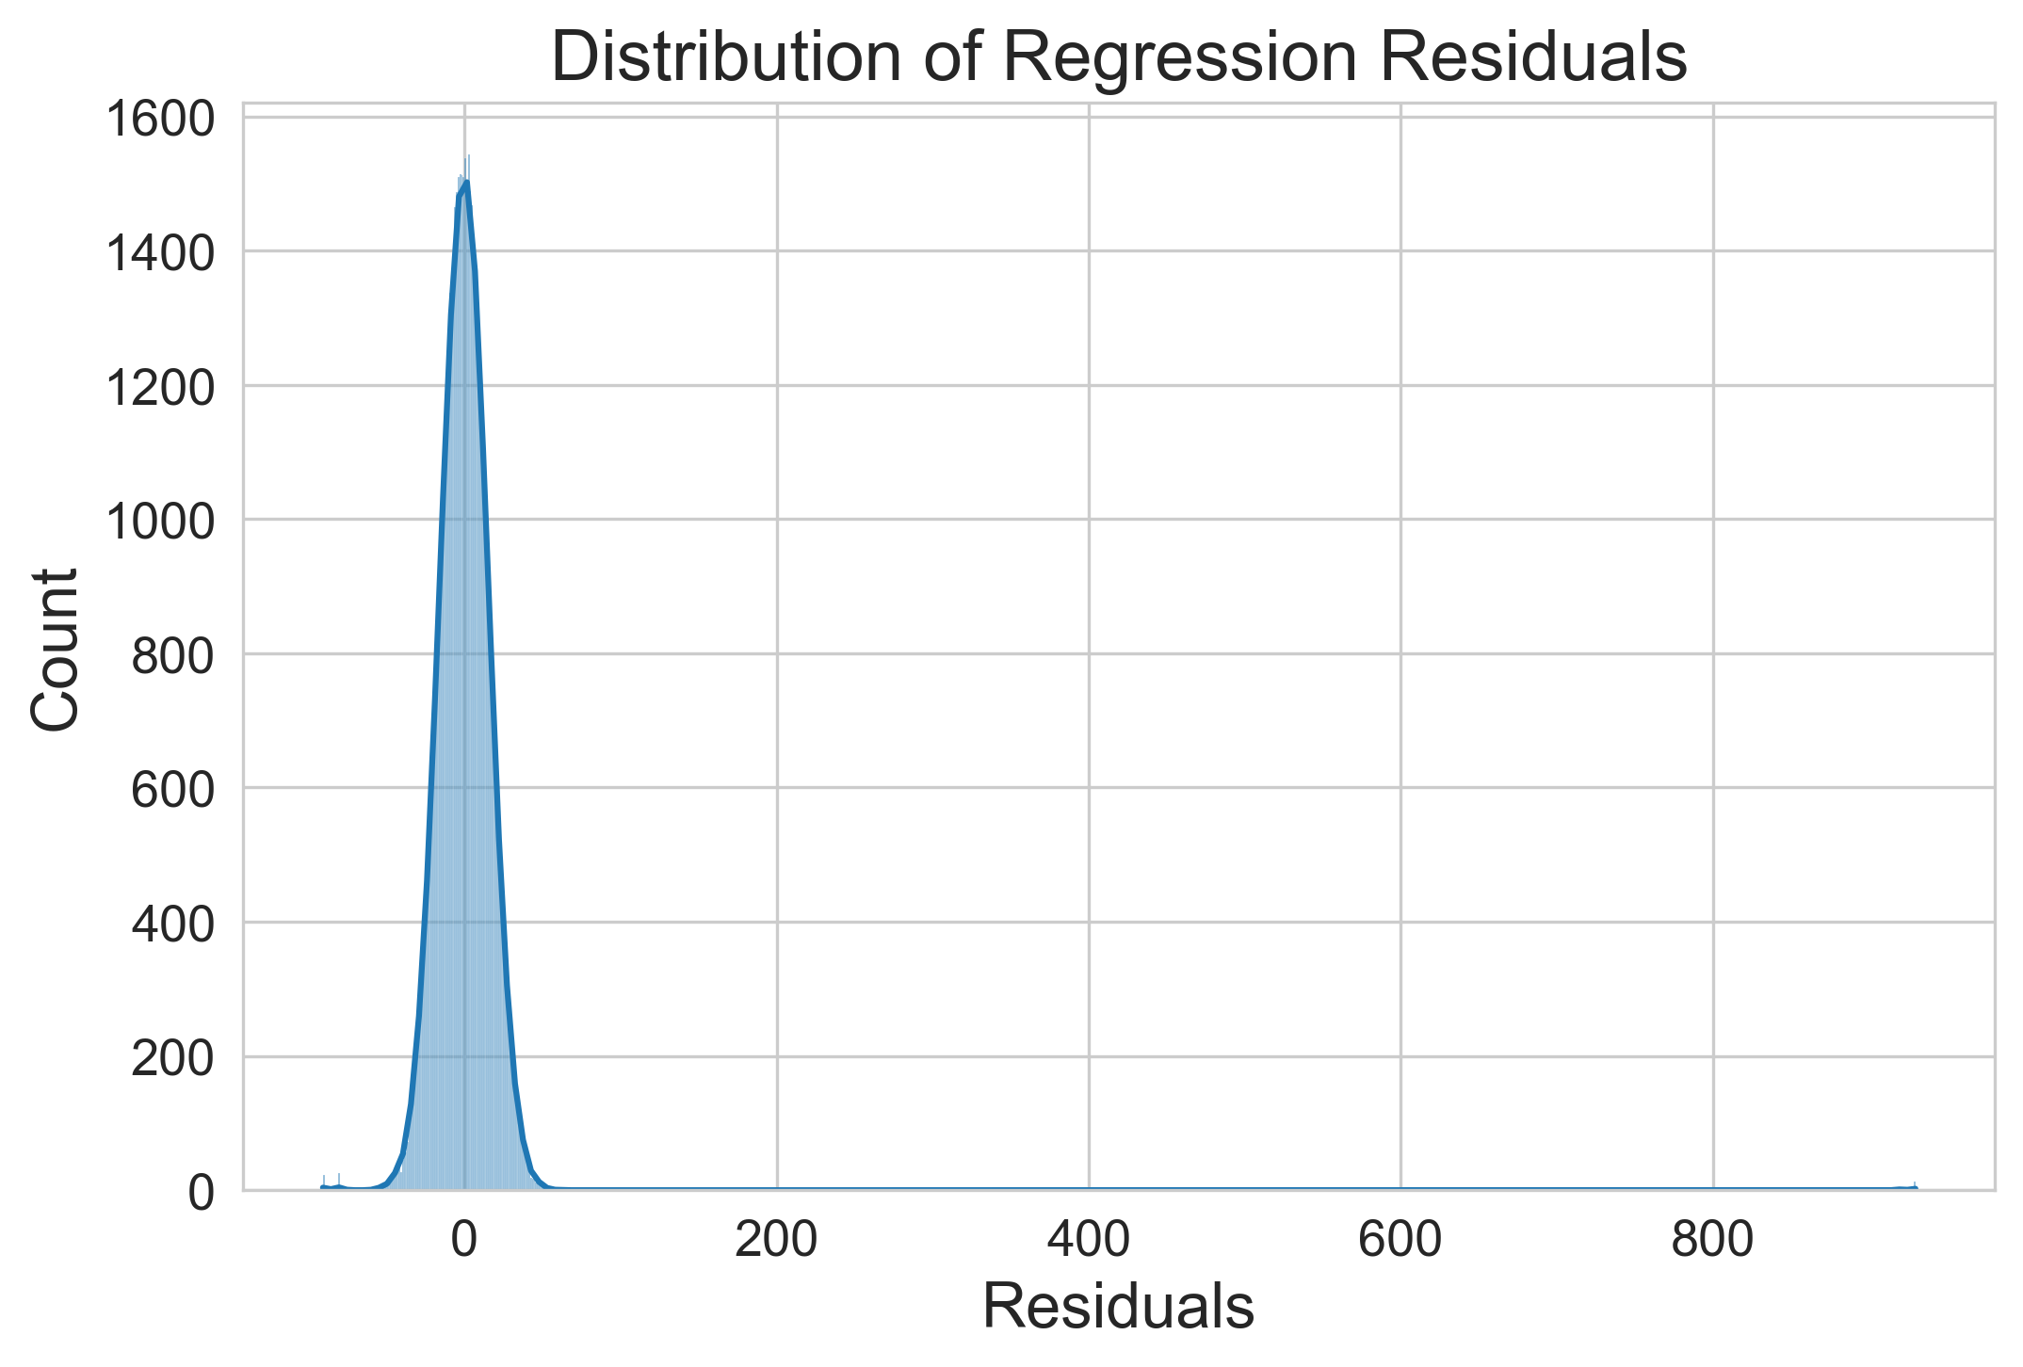
Model Diagnostics
Visual 3 – Regression Residuals Distribution

Slide 7
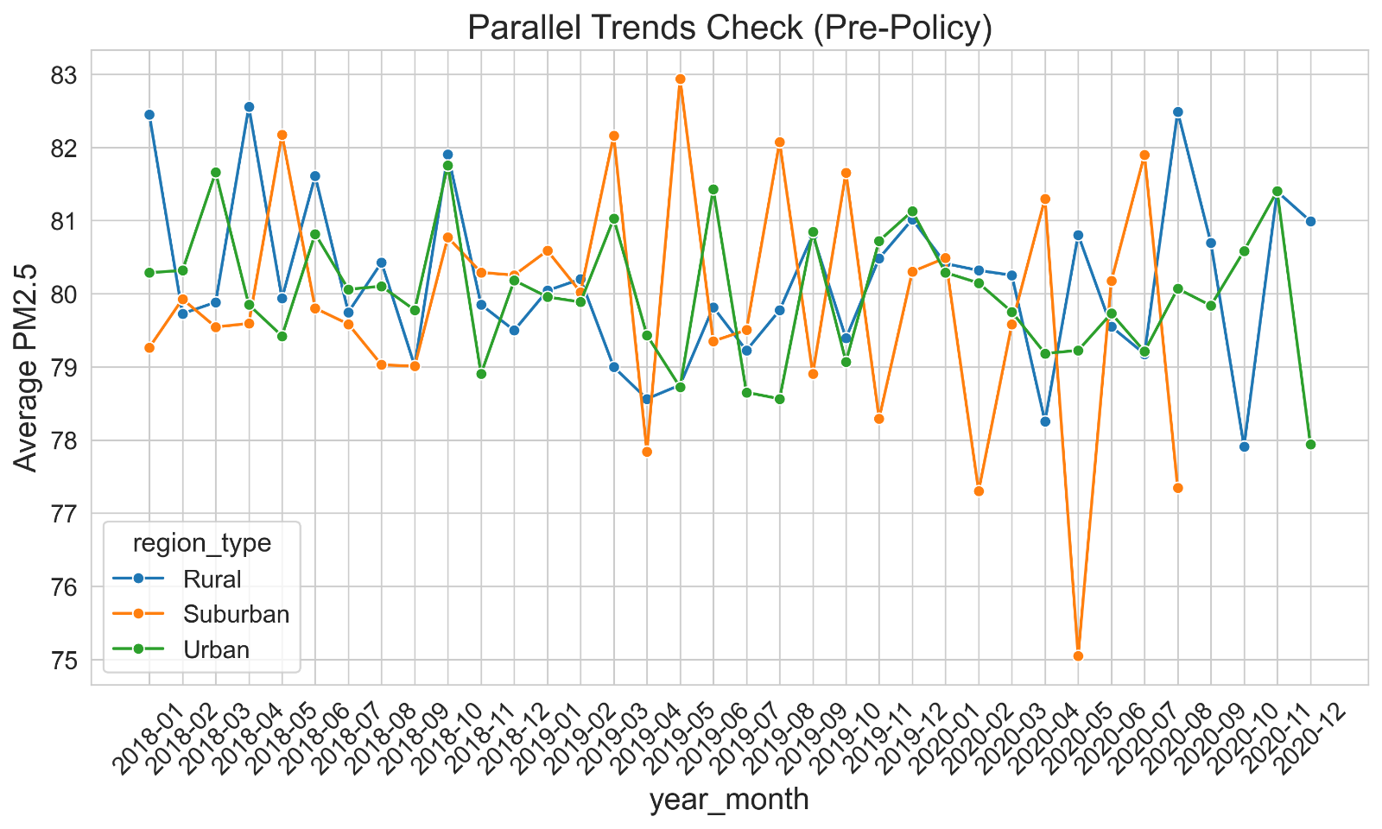
Visual 4 – Parallel Trends Check (Pre-policy)

Slide 8
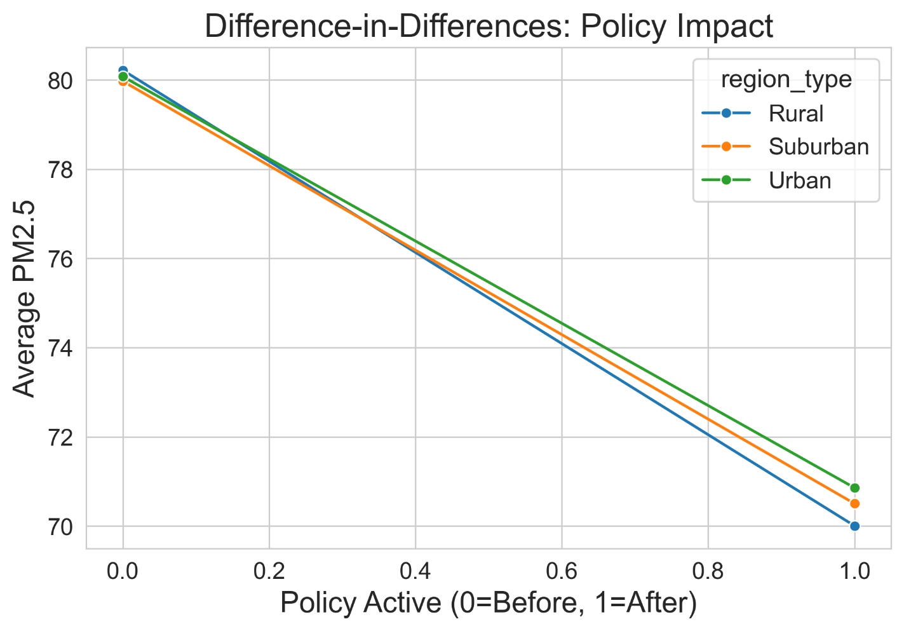
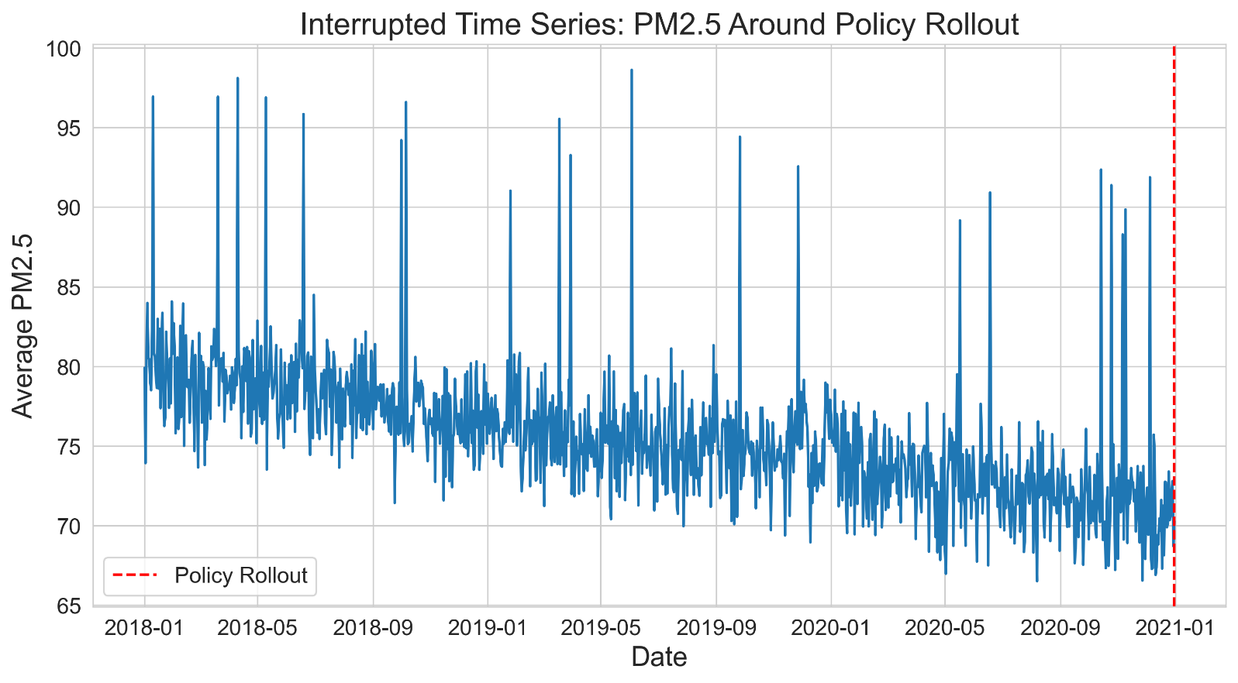
Policy Impact Analysis Visualizations
Visual 5 – Difference-in-Differences (by region)
Visual 6 – Interrupted Time Series (policy rollout)

Slide 9
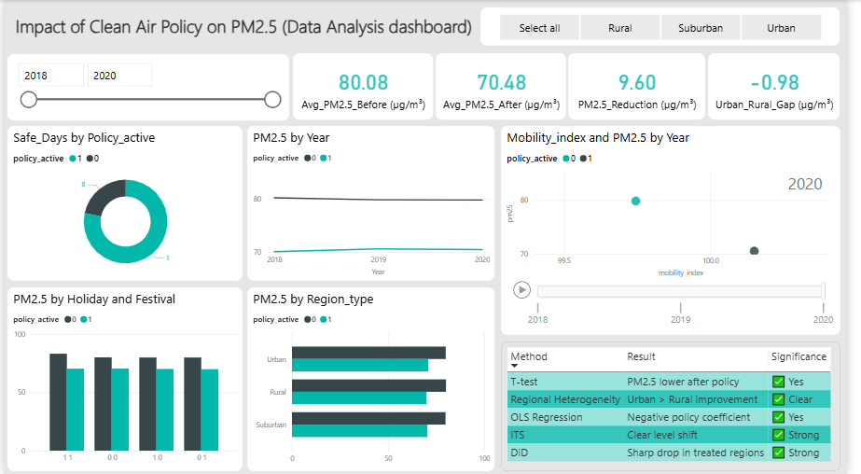
Dashboard: Policy Effectiveness Summary

Slide 10
Results Summary
Analysis Method
Result
Significance
Mean Comparison (T-test)
PM2.5 lower after the policy
✅ Yes (p < 0.05)
OLS Regression
Policy coefficient negative (-)
✅ Yes
Parallel Trends Check
Pre-policy trends parallel
✅ Valid
Difference-in-Differences
Sharp drop in treated vs control
✅ Strong
Interrupted Time Series (ITS)
Level shift at policy rollout
✅ Strong
Regional Heterogeneity
Urban regions improved more
✅ Clear

Slide 11
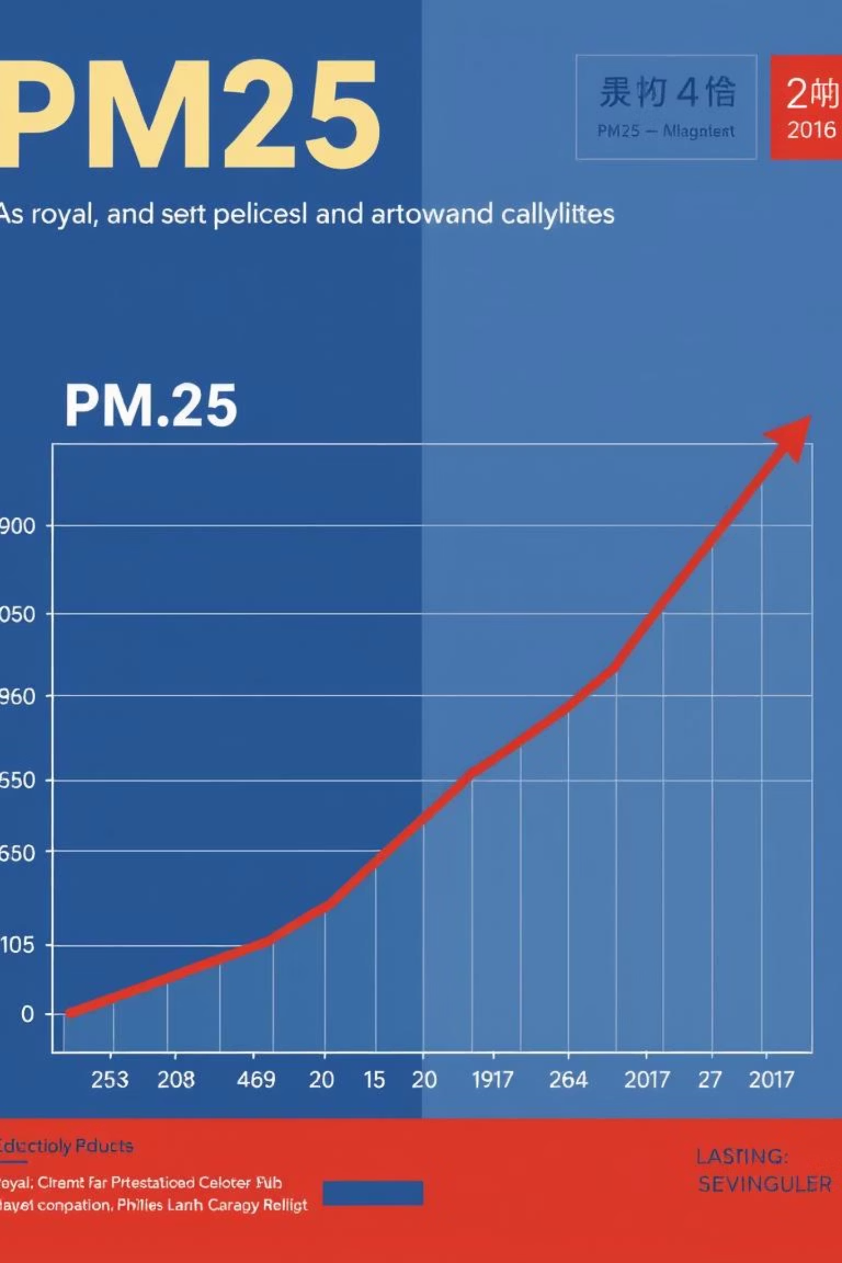
Conclusion & Policy Recommendations
The Clean Air Policy successfully reduced PM2.5 levels by approximately 10 units on average.
Observed effects are statistically significant and robust across multiple analytical methods.
Urban regions experienced greater improvement in air quality compared to rural areas.

Slide 12




Future Policy Directions
Extend Interventions
Strengthen Enforcement
Complementary Measures
Focus on implementing targeted clean air initiatives and support programs in rural regions to achieve equitable outcomes.
Enhance regulatory oversight and increase penalties for non-compliance to ensure sustained reductions in emissions.
Introduce additional policies such as traffic restrictions in high-pollution areas and incentives for clean energy adoption.

Slide 13

Thank You

